Slide 1

U.S. Senate Elections Analysis (1976–2020)
MATH-014-01
Camille Settles
April 24, 2025

Slide 2
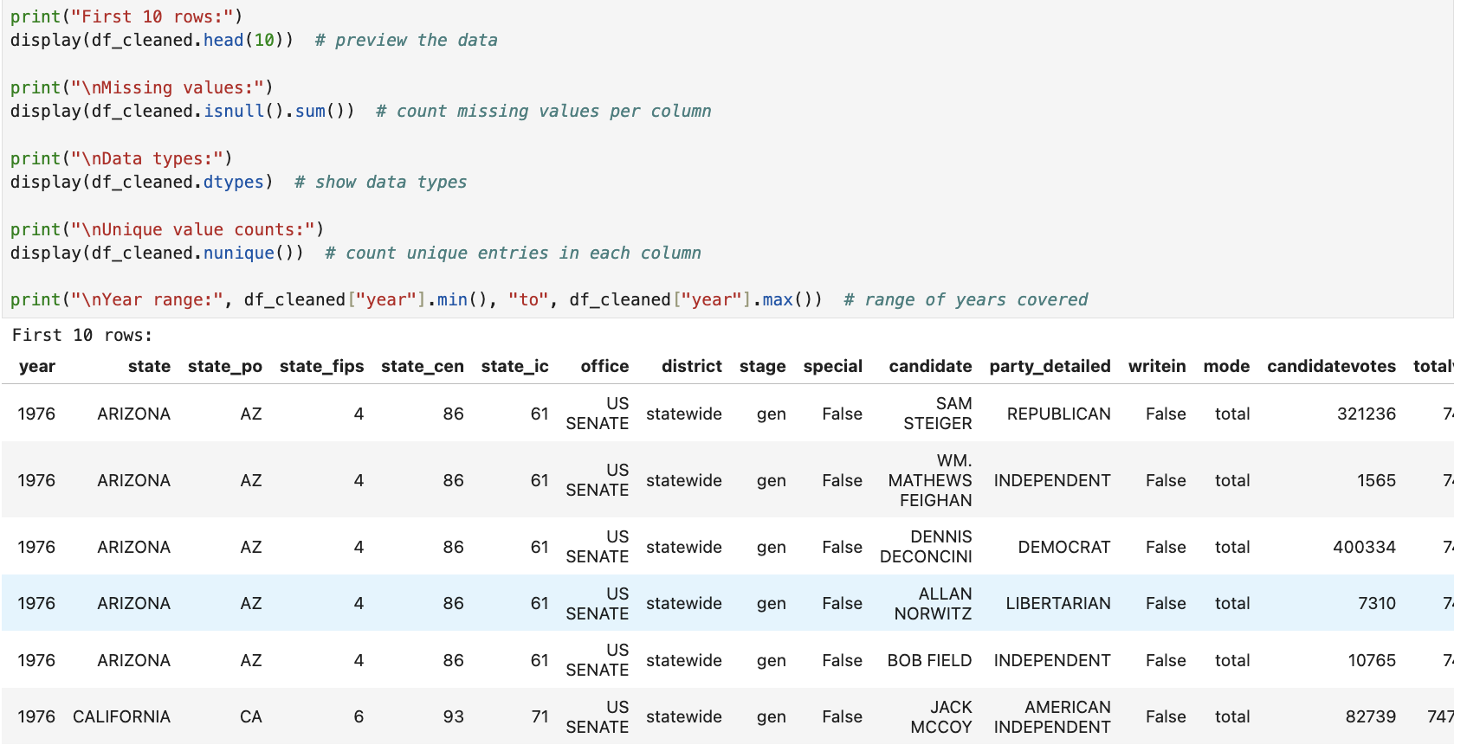
Objective and Data Introduction
Analyze U.S. Senate election trends from 1976 to 2020 using a structured dataset.
Discover patterns in voter turnout, party dominance, and top-performing candidates.
Use Python (pandas, matplotlib, seaborn, plotly) to conduct exploratory data analysis and generate visualizations.
Investigate the influence of state population, party affiliation, and candidate incumbancy on voting outcomes.
The significance of the study is to understand voter behavior, visualize party dominance and create data driven insights.
Dataset Source: Kaggle – U.S. Senate Elections (1976–2020).
This project focuses on the Senate races only.
Downloaded in CSV format and Conducted in Python using pandas, matplotlib, seaborn, and plotly for analysis and visualization.
Raw data included over 18,000+ rows and covered all 50 states across 44 years of elections.
Key fields: state, year, candidate, party, totalvotes, candidatevotes, writein, etc.

Slide 3
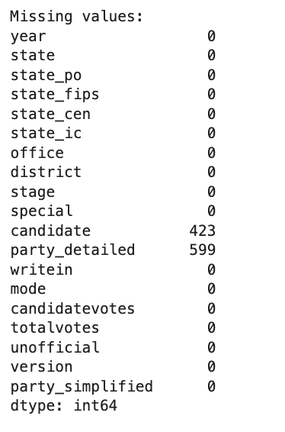
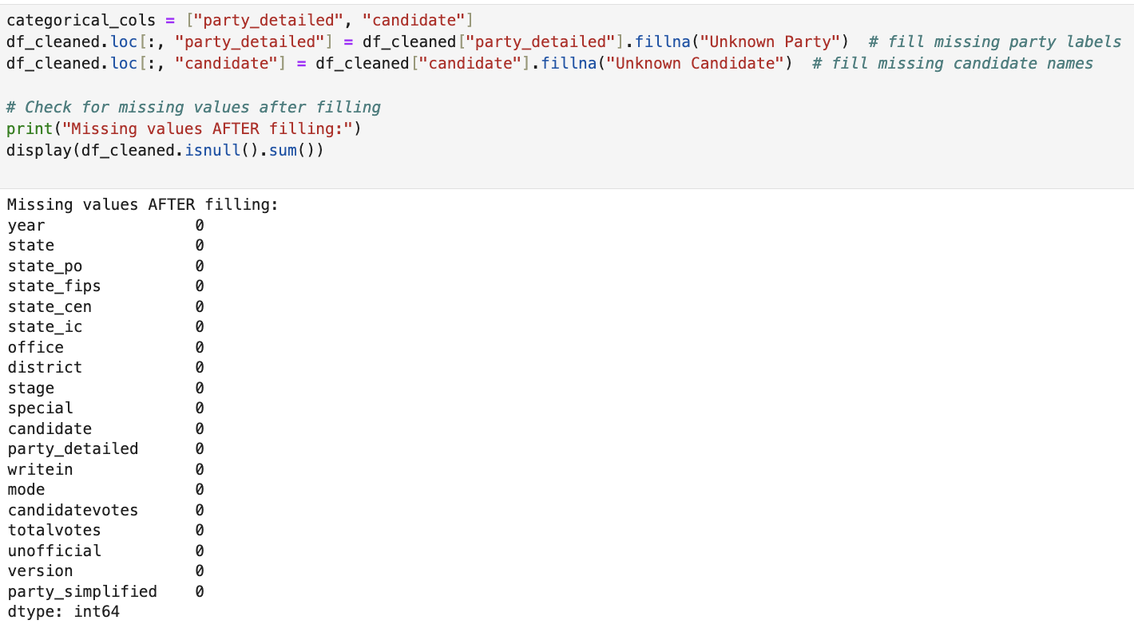
Method: Data Cleaning Summary
Loaded over 18,000 rows of raw candidate-level data
Filled missing values in candidate and party_detailed with "Unknown Party" and "Unknown Candidate"
Verified no missing values in numerical columns
Confirmed that there were no invalid or negative votes
No duplicate rows
Converted year column from integer to datetime format to support time-series analysis

Slide 4
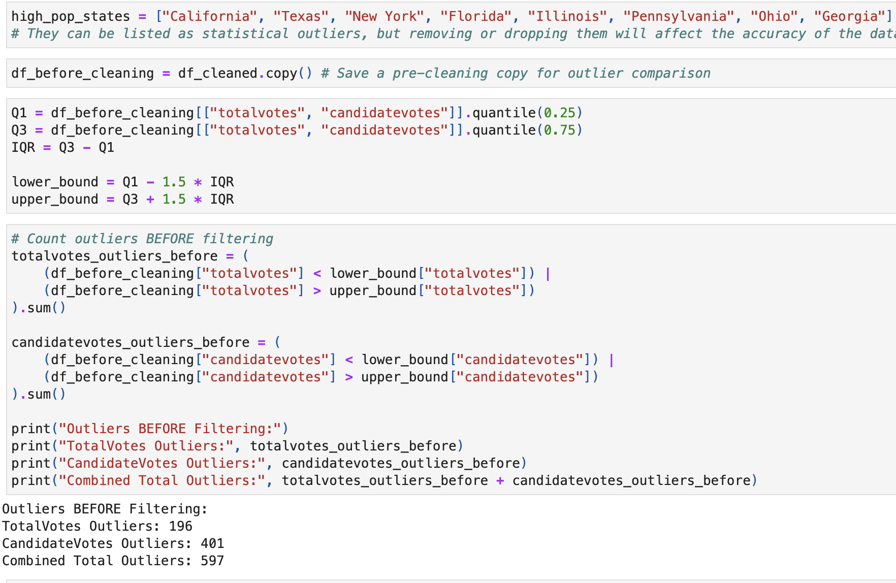
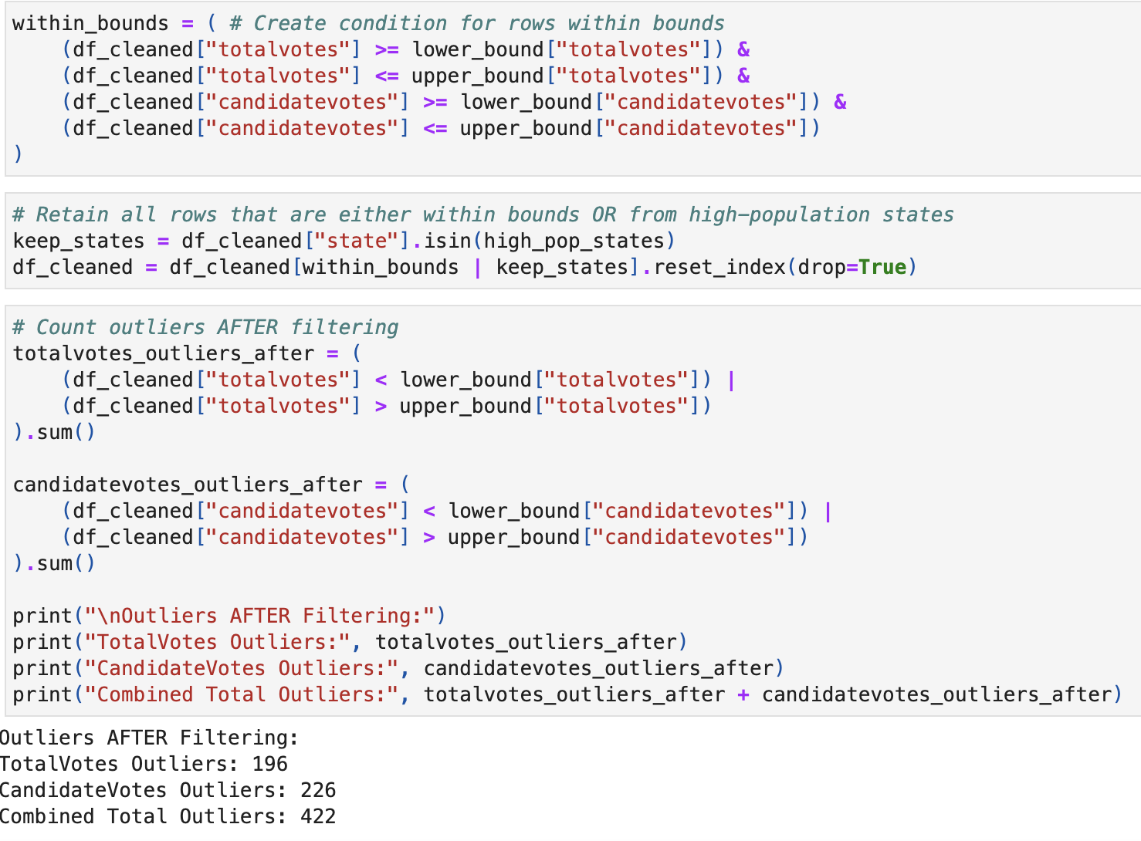
Data Cleaning- Continued
Used IQR to detect outliers in totalvotes and candidatevotes
Initially removed high-end outliers → caused loss of key states like CA, TX
Upon review, I realized essential states were missing, making the visual analysis misleading and incomplete
Refined strategy to keep accuracy and representation:
Step 1: Calculated lower and upper IQR bounds for vote columns
Step 2: Created a condition to retain rows that:
Fell within IQR bounds, or
Belonged to known high-population states (CA, TX, NY, etc.)
Step 3: Applied the condition using a boolean mask and reset index
Outcome:
196 totalvotes outliers retained
226 candidatevotes outliers retained
All high-population states preserved

Slide 5
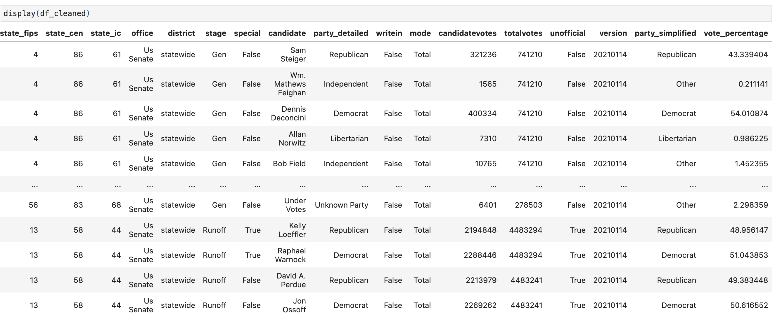
Continued-
Applied string normalization to ensure consistent formatting in key categorical columns
→ Columns: state, candidate, party_detailed, party_simplified, office, mode, and stage
Steps Taken:
Removed leading and trailing whitespace
Converted all text entries to Title Case (e.g., democrat → Democrat)
Ensured consistent casing and formatting for accurate grouping and plotting
Prevented issues with:
Duplicated party names written differently (e.g., "democrat" vs. "Democrat")
Created a new column: vote_percentage → Formula: (candidatevotes / totalvotes) * 100
Shows how much of the vote share each candidate received

Slide 6
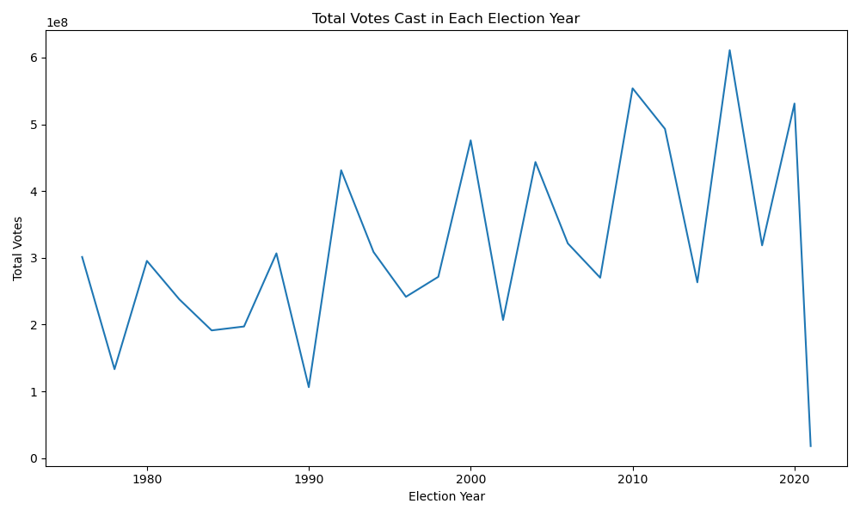
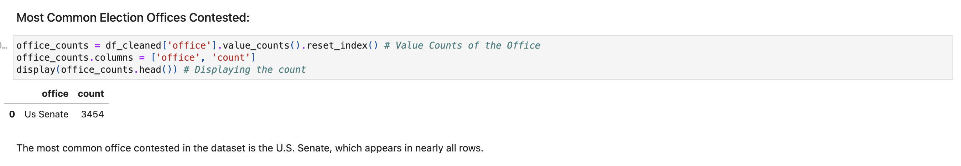
Data Visualizations: Total Votes Over Time (1976–2020) and Most Common Election Offices Contested
Line chart showing total votes by election year
Clear upward trend, peaking in 2020
Spikes in 2008, 2012, 2016, and 2020 reflect high-engagement cycles
May indicate increased political engagement and participation
The sharp drop in 2021 may be because of the pandemic and write-in votes.
Data confirms Senate elections are drawing more voters over time

Slide 7
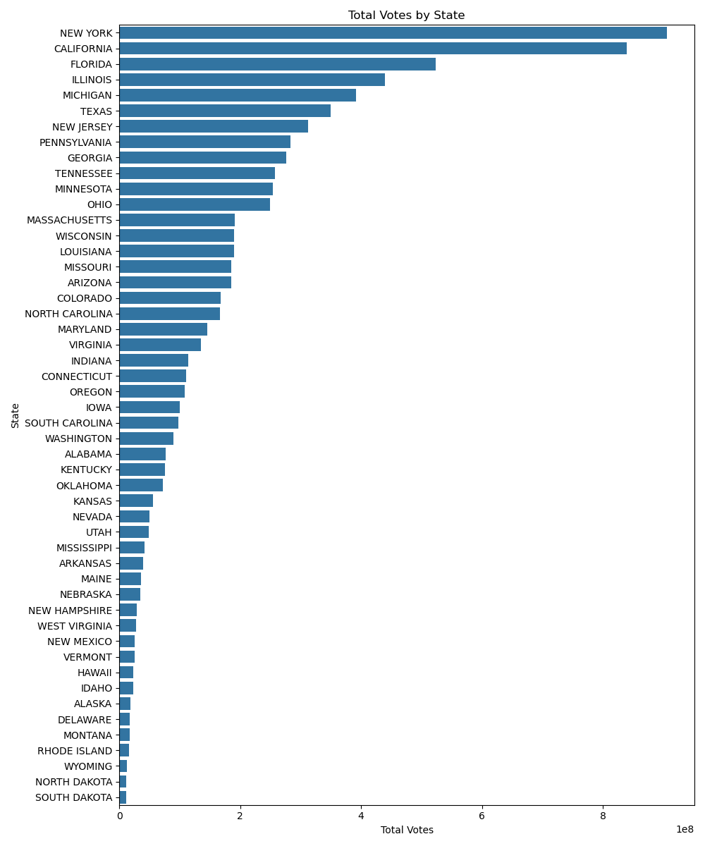
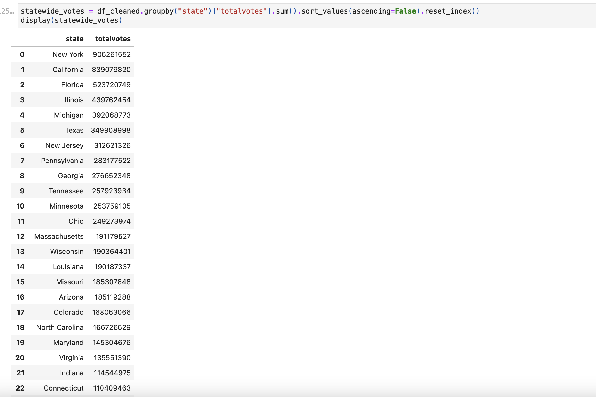
State-wide Total Vote Distribution:
Bar chart comparing total votes by state
California, Texas, New York, Florida, Illinois, Michigan, consistently dominate the votes
High vote counts correlate with population size
Justifies keeping these high-population states despite outlier status

Slide 8
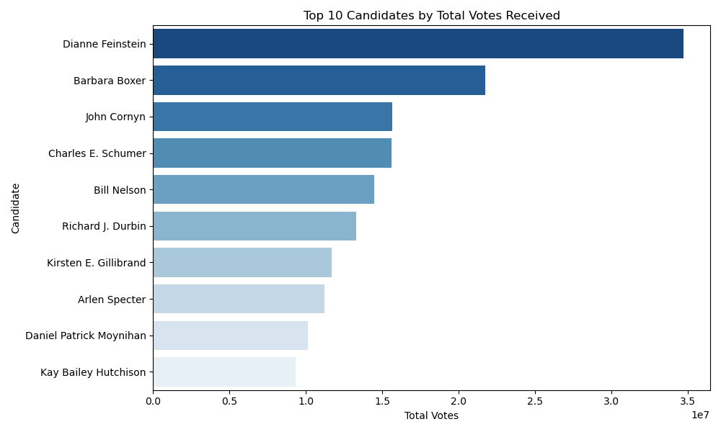
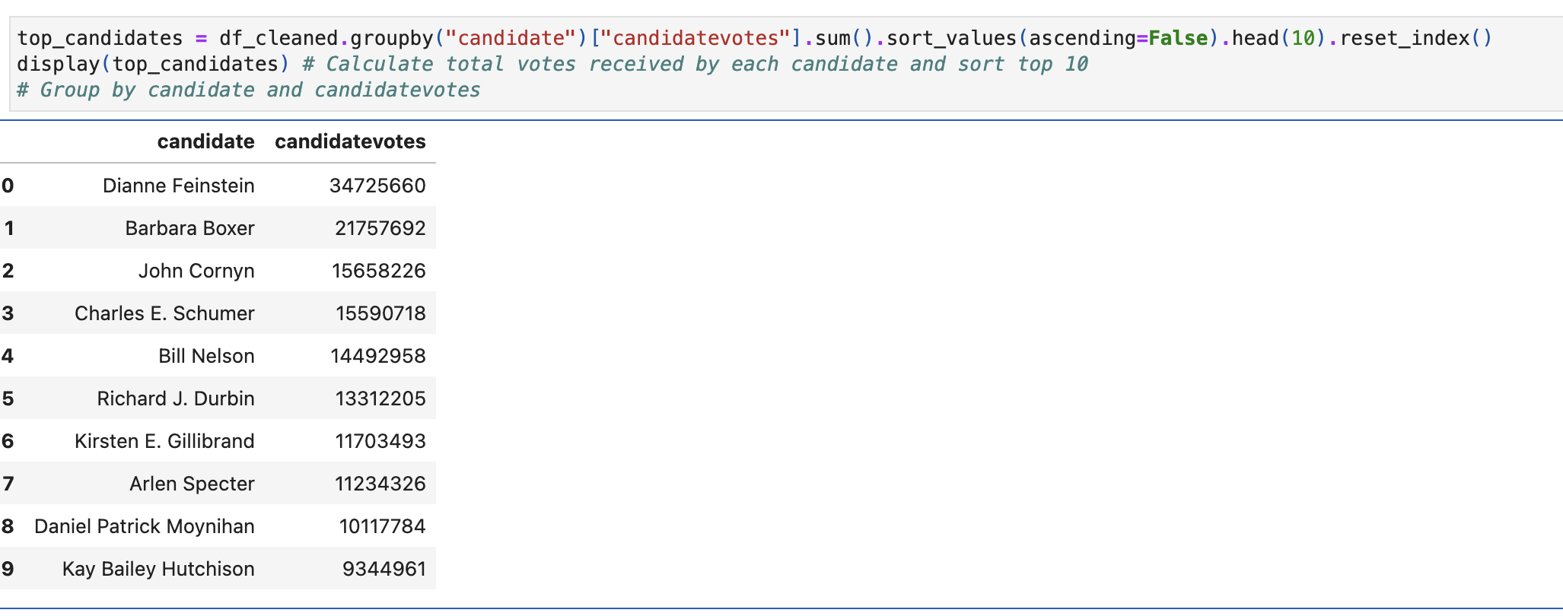
Top Candidates by Vote Count:
The top three candidates who received the highest total votes across all Senate elections in the dataset are:
Dianne Feinstein (California) – 34,725,660 votes
Barbara Boxer (California) – 21,757,692 votes
John Cornyn (Texas) – 15,658,226 votes
Reflects incumbency advantage and large voter base
Shows how state size amplifies individual candidates' totals

Slide 9
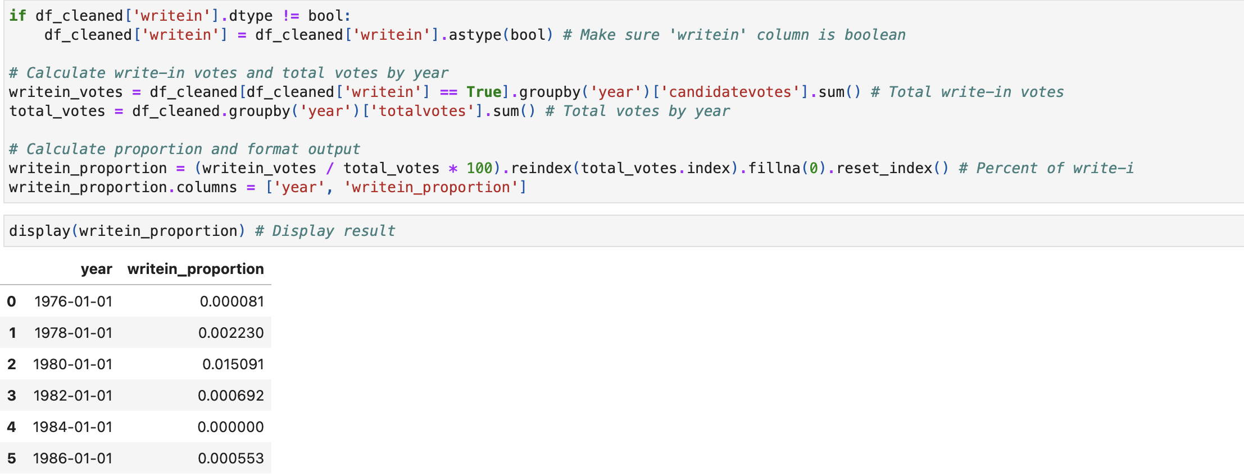
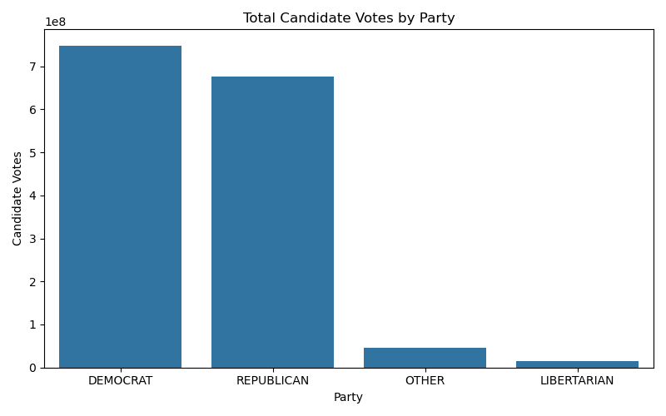
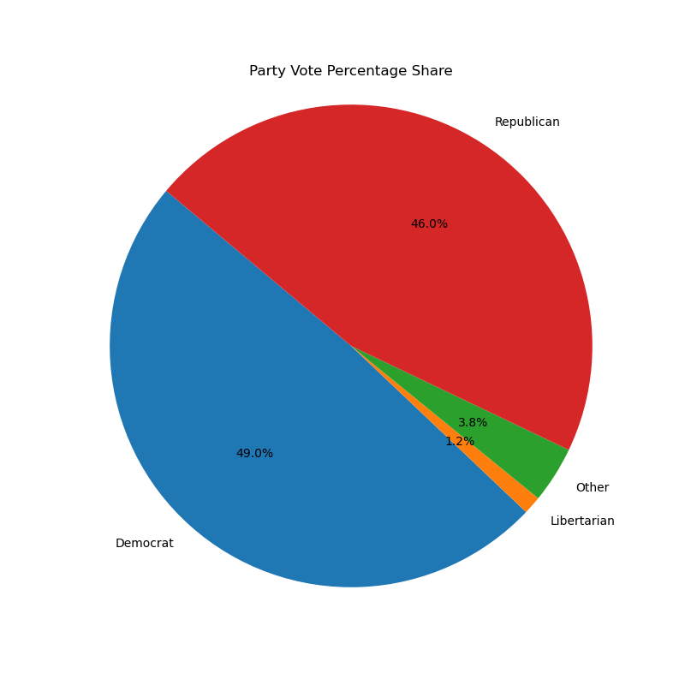
Proportion of Write In Votes Over the Years and Party Distribution Pie Chart:
Write-in votes are extremely rare, making up less than 0.01% of total Senate votes in most years
Notable write-in spikes occurred in 1990 and 2021
The bar chart displays the total number of candidate votes each party received across all elections from 1976–2020.
Democrats and Republicans together received over 1.4 billion votes combined, with Democrats slightly ahead.
Third parties (Libertarian, Other) received a very small fraction of total votes, which is clearly visible here.
The pie chart shows the same data in percentage form, offering a normalized view:

Slide 10
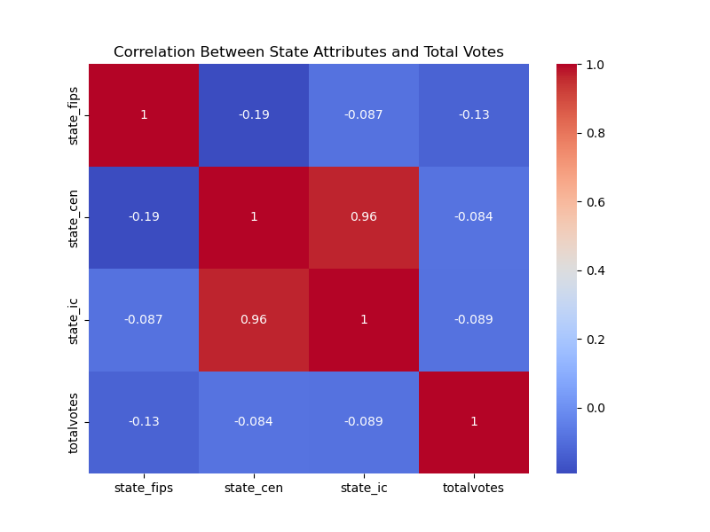
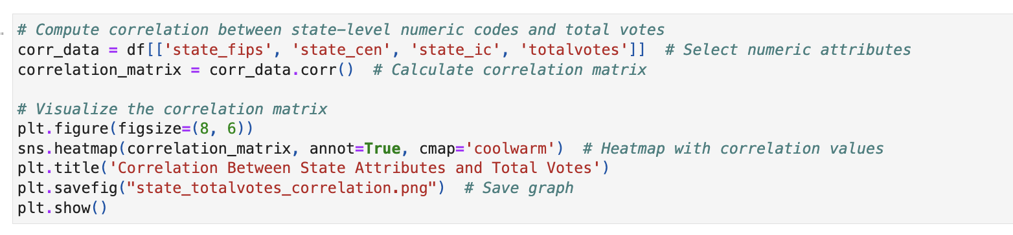
Correlation & Geographic Codes Analysis:
Ran .corr() method on vote totals vs. state_fips, state_cen, and state_ic
Found correlation coefficients close to zero
Confirms codes are only for geographic identification = not predictive
Reinforces that state population and political culture are more meaningful factors

Slide 11
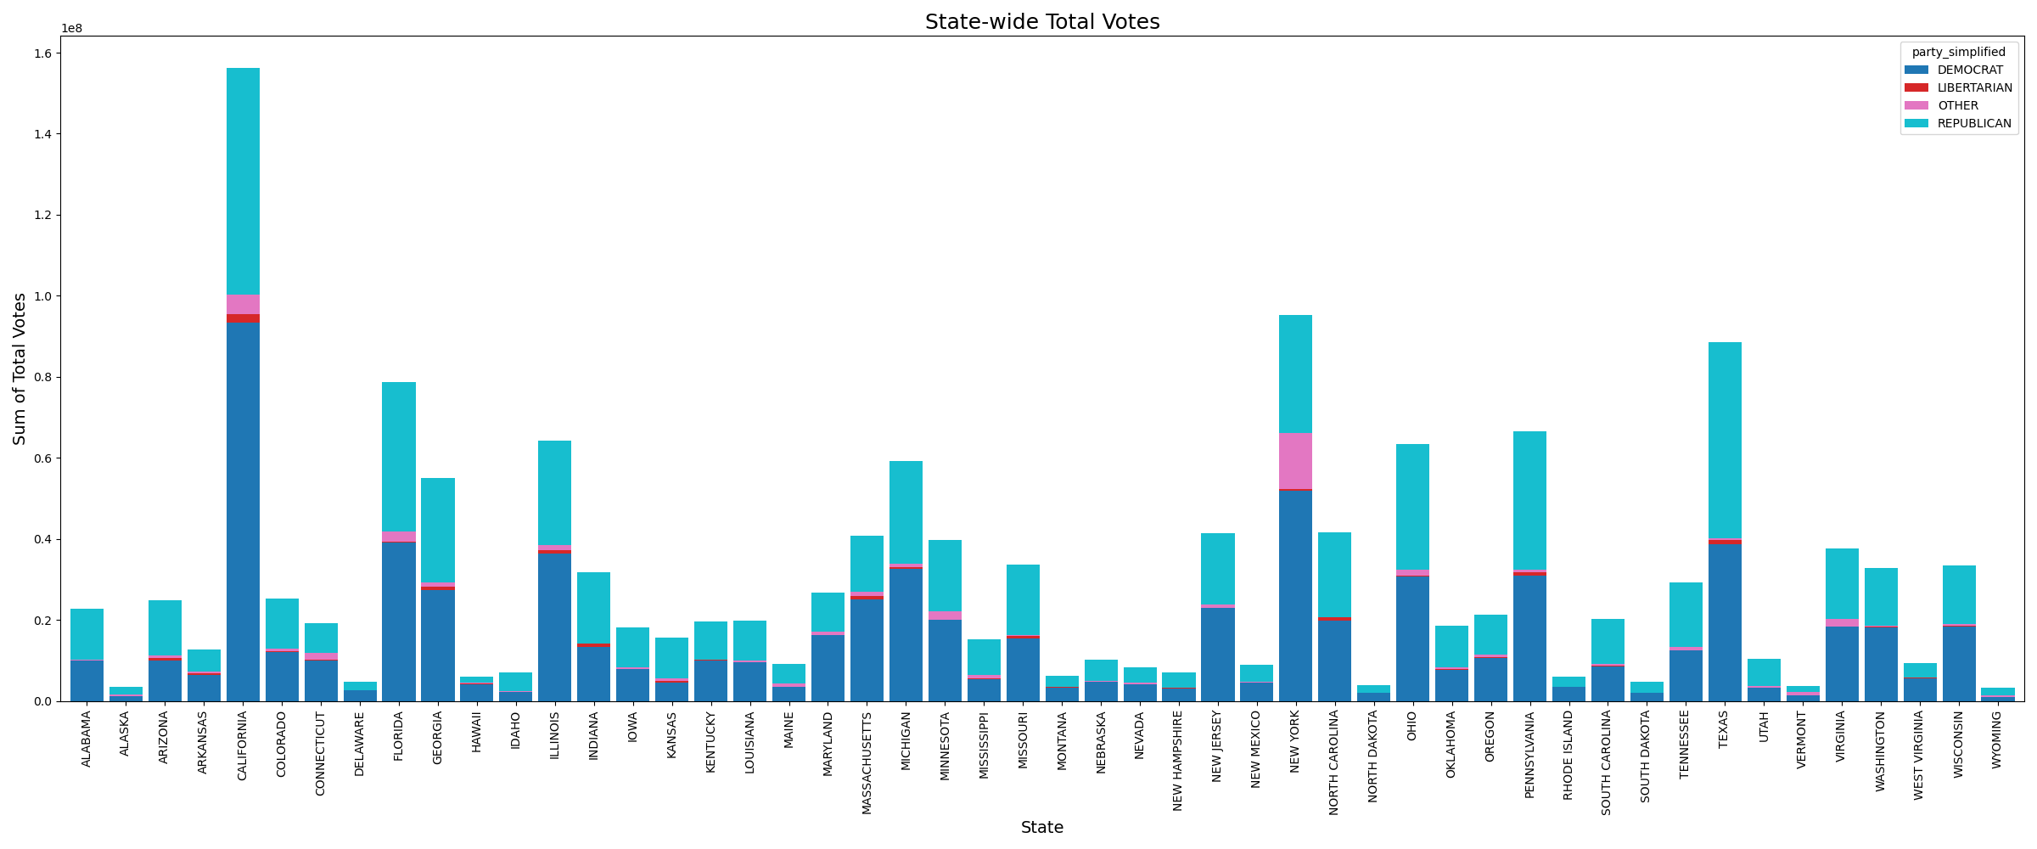
Expected Output and Remaining Sections:
Question 1: How does the total number of votes vary across different states, and how do the vote distributions differ by party?
The total number of votes cast in Senate elections varies greatly across states, primarily due to population size. States like California, New York, and Texas contribute the highest total votes, while smaller states like Wyoming, Vermont, and Michigan, etc. have significantly lower turnout figures.
- Democrats and Republicans consistently receive the largest share of votes in nearly every state, dominating the electoral landscape.
- Other parties receive some support, often concentrated in specific regions or election years.
- Libertarian candidates appear less frequently but still gather measurable support in several states (minor party influence).

Slide 12
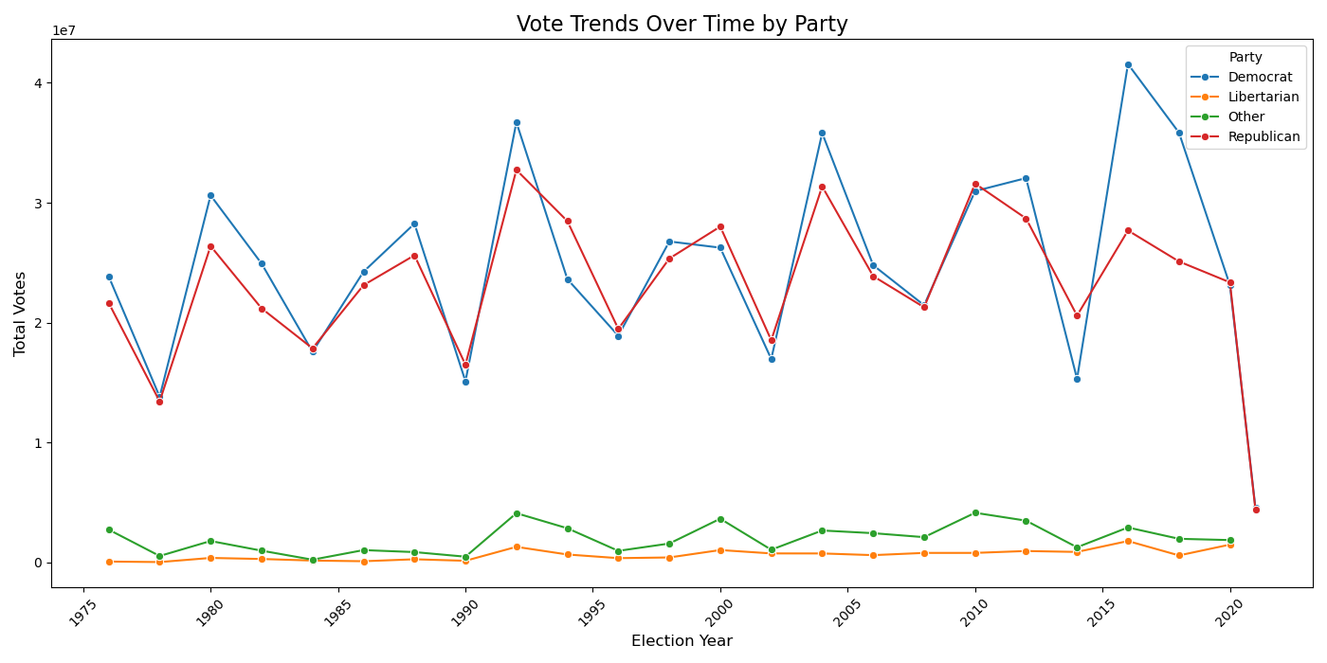
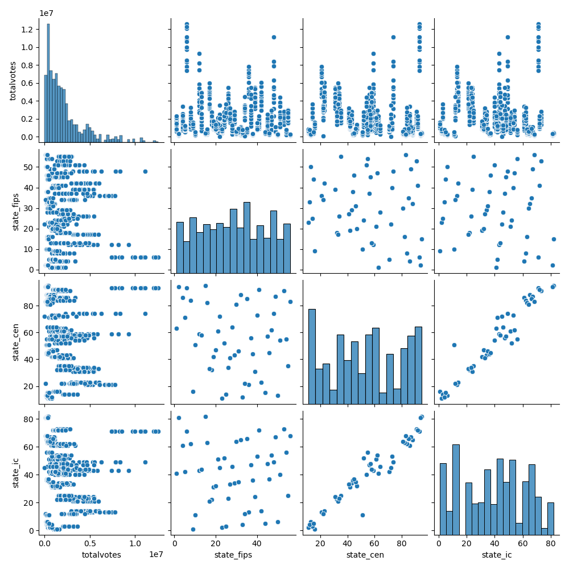
Additional Insights and Pair Plot:
The graph supports the idea that the U.S. political system remains largely a two-party structure.
The pair plot visualizes the relationships between numeric columns: totalvotes, state_fips, state_cen, and state_ic.
Clear clustering or linear relationships were not observed between vote totals and state identifiers.
The scatter plots indicate that state-level numeric codes (fips, cen, ic) do not predict vote totals, reaffirming the earlier correlation matrix.

Slide 13
Conclusion & General Insights:
Population is a major determinant of vote counts. States like California and Texas consistently produce the highest totals.
Democratic and Republican parties overwhelmingly dominate the vote share — together accounting for over 98% of all candidate votes.
Third-party candidates (e.g., Libertarians) receive small but notable support, often tied to specific political movements or election cycles.
Write-in votes remain rare, but surges in 1990 and 2021 may reflect protest or nontraditional voter behavior.
Outlier handling was critical to keep high-population states in the analysis without distorting trends.
Candidate Popularity: Long-term incumbents from populous states, such as Dianne Feinstein and Barbara Boxer, lead in cumulative votes—showcasing how tenure and state size amplify a candidate’s electoral presence.
No Significant Correlation with State Codes: Variables like state_fips, state_ic, and state_cen had little correlation with total votes, emphasizing that demographics and political engagement matter more than code-based identifiers.

Slide 14
References & Acknowledgments:
Kaggle Dataset: U.S. Senate Elections 1976–2020
Senate Dataset
Python Libraries: pandas, matplotlib, seaborn, plotly
Matplotlib & Seaborn Documentation

